Slide 1

Individual Differences in Cognitive Control: From a General Introduction to Hierarchical Bayesian Models
Jean-Paul Snijder
Colloquium at Universität Ulm
28th July 2022

Slide 2
Outline
Recent history of cognitive control
Reliability and Measurement
Frequentist Approach (to cognitive control reliability)
Hierarchical Bayesian Approach (to cognitive control reliability)
Current Research and Future Directions

Slide 3
I. Introduction and Recent History of Cognitive Control

Slide 4



Cognitive Control
“Deliberate regulation of information processing to facilitate goal-directed behavior”
Focus
Concentration
Paying attention

Slide 5
Also;
Cognitive Control
Deliberate regulation of information processing
Focus
Concentration
Paying attention
Executive Function
Attentional Control
Executive Control

Slide 6
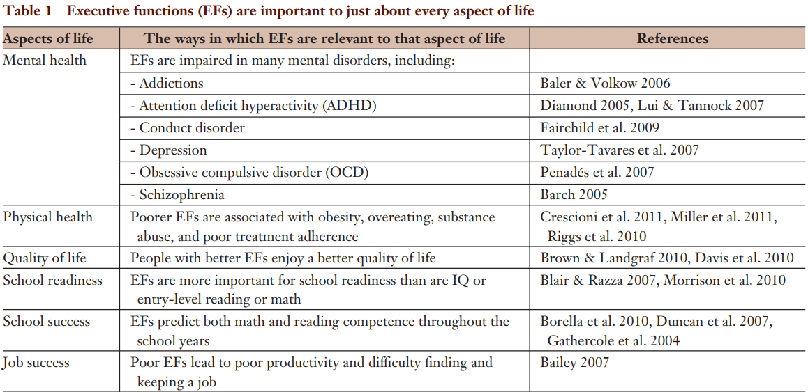
Table from Diamond, 2013.
Applications of Cognitive Control

Slide 7
Applications of Cognitive Control
Table from Diamond, 2013.

Slide 8
Applications of Cognitive Control
Table from Diamond, 2013.

Slide 9
Theoretical Applications
Intelligence
Executive Attention Theory
Engle & Kane, 2004
Process Overlap Theory
Kovacs & Conway, 2016
Mutualism Model
van der Maas et al., 2006

Slide 10
WMC <-> Intelligence
Theoretical Applications
Intelligence
Executive Attention Theory
Engle & Kane, 2004
Process Overlap Theory
Kovacs & Conway, 2016
Mutualism Model
van der Maas et al., 2006

Slide 11
WMC <cognitive control> Intelligence
Theoretical Applications
Intelligence
Executive Attention Theory
Engle & Kane, 2004
Process Overlap Theory
Kovacs & Conway, 2016
Mutualism Model
van der Maas et al., 2006

Slide 12
Limitations and Current State
Cognitive control is important

Slide 13
Limitations and Current State
Cognitive control is important
Reliability paradox (Hedge et al., 2018):
Experimentally robust
Poor reliability

Slide 14
Limitations and Current State
Cognitive control is important
Reliability paradox (Hedge et al., 2018):
Experimentally robust
Poor reliability
Cronbach, 1957:
“Individual differences have been an annoyance rather than a challenge to the experimenter”

Slide 15
Limitations and Current State
Stroop
Experimentally robust:
Many Labs 3
Out of 10 effects tested: 3 were replicable
The Stroop was one of them
Incongruency cost: higher errors/slower responses
“Everybody Stroops” - Rouder & Haaf, 2017
BLUE
RED
YELLOW
GREEN

Slide 16
Limitations and Current State
Stroop
Experimentally robust:
Many Labs 3
Incongruency cost: higher errors/slower responses
“Everybody Stroops” - Rouder & Haaf, 2017
Poor reliability
Stroop: Hedge et al., 2018: ICC ~ .55
Test-retest reliability
Inhibition: von Bastian et al., 2020: r ~ .63

Slide 17
Limitations and Current State
Between-task Correlations
Below what is expected
Inhibition tasks:
Stroop
Antisaccade
r = ??
Stop-signal
Go/no-go

Slide 18
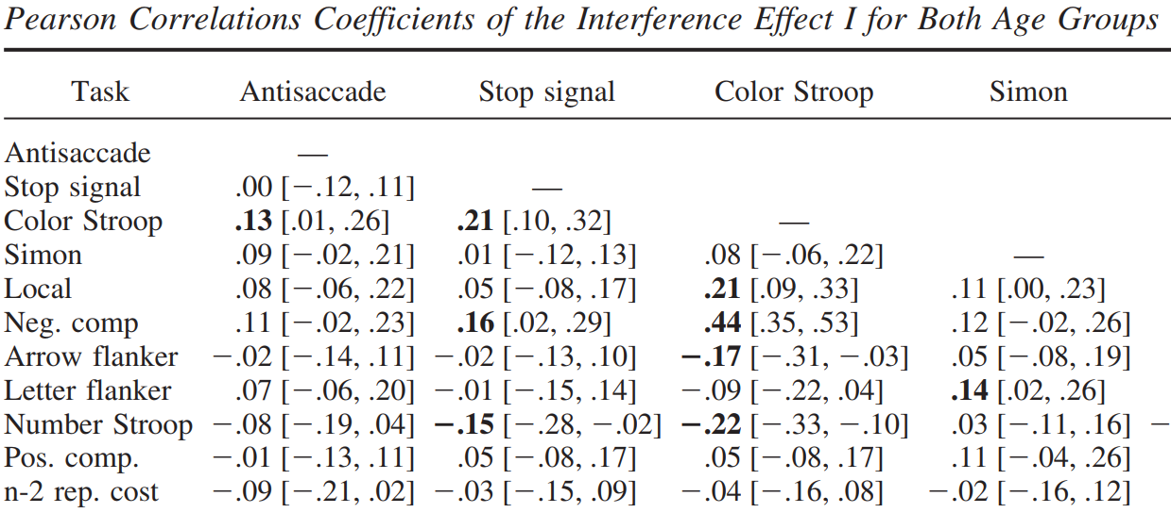
Rey-Mermet et al., 2018
Correlation between control measures
Mean correlation per sample

Slide 19
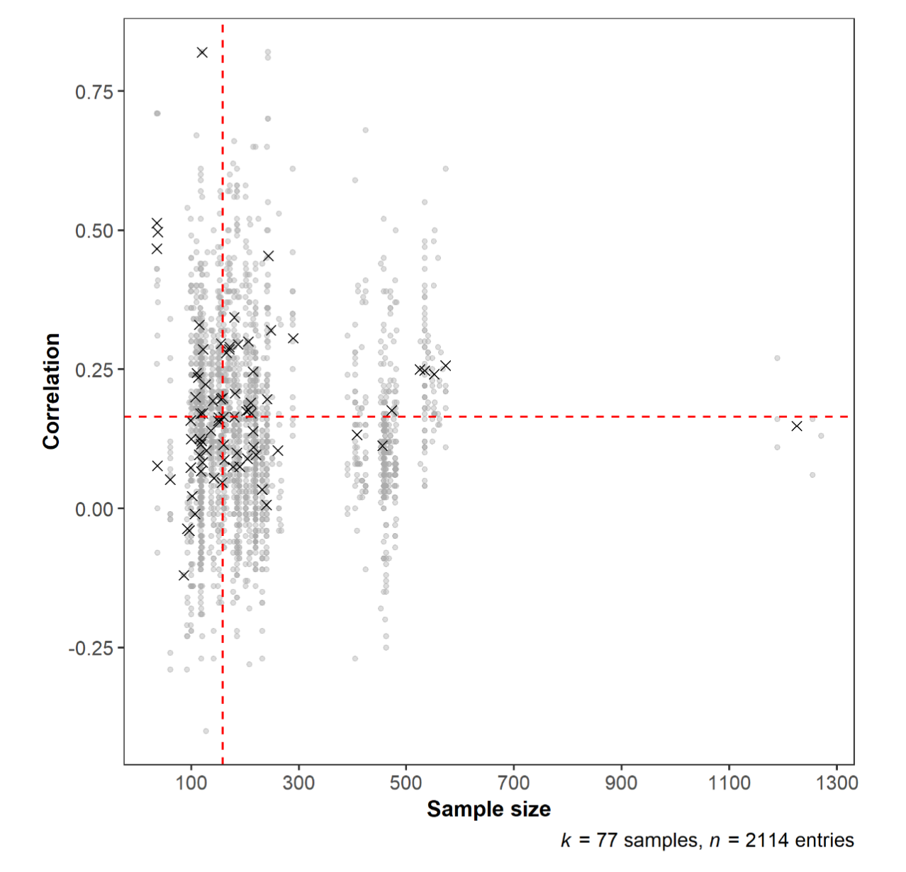
von Bastian et al., 2020
Correlation between control measures
Mean correlation per sample

Slide 20
Why are the existing measures unreliable?
First take
Weak between-task correlations
Current psychometric construct doesn’t exist:
E.g., Friedman et al., 2016; Frischkorn et al., 2019; Rey-Mermet et al., 2019, and more

Slide 21
Why are the existing measures unreliable?
First take
Weak between-task correlations
Current psychometric construct doesn’t exist:
E.g., Friedman et al., 2016; Frischkorn et al., 2019; Rey-Mermet et al., 2019, and more
“These findings call into question the existence of
[cognitive] control as a psychometric construct” – Rey-Mermet et al. 2018

Slide 22
Why are the existing measures unreliable?
Second Take
Measurement issues
Difference scores
Improper Reliability estimation
E.g., Hedge et al., 2018, Draheim et al., 2020

Slide 23
Why are the existing measures unreliable?
Second Take
Measurement issues
Difference scores
Improper Reliability estimation
E.g., Hedge et al., 2018, Draheim et al., 2020
“…that the lack of relationship among common [cognitive] control measures is due to failures of the tasks used to measure attention, and not due to theoretical considerations. ”

Slide 24
Why are the existing measures unreliable?
Dissertation (2019-2021)
Measurement issues
Difference scores
Reliability
Our stance:
Measurement issues should be examined

Slide 25
II. Reliability and Measurement

Slide 26
Reliability Definition
Experimental: replication of an effect
E.g., does the desired effect occur?
Low between-subject variability
Considered measurement error
Correlational: ranking of effect size
E.g., how does the difference in effect size predict …?
High between-subject variability
Easier to rank

Slide 27
Reliability Definition
Experimental:
Low between-subject variability
Considered measurement error
Minimized in experiment design
Correlational:
High between-subject variability
Easier to rank

Slide 28
Result
Reliability Definition
Experimental:
Low between-subject variability
Considered measurement error
Minimized in experiment design
Correlational:
High between-subject variability
Easier to rank
experimental tasks might not be suitable in individual differences research

Slide 29
Difference Scores
E.g., Stroop Effect
Incongruent – Congruent = Stroop Effect

Slide 30
Difference Scores
E.g., Stroop Effect
Incongruent – Congruent = Stroop Effect
Psychometrically problematic for reliability
Caruso, 2004; Cronbach & Furby, 1970; Lord, 1956
Reliability: difference score < components

Slide 31
Difference Scores
E.g., Stroop Effect
Incongruent – Congruent = Stroop Effect
Psychometrically problematic for reliability
Caruso, 2004; Cronbach & Furby, 1970; Lord, 1956
Reliability: difference score < components
Ratio: Measurement error vs. between-subject variance increases

Slide 32
Difference Scores
E.g., Stroop Effect
Incongruent – Congruent = Stroop Effect
Psychometrically problematic for reliability
Caruso, 2004; Cronbach & Furby, 1970; Lord, 1956
Reliability: difference score < components
Ratio: Measurement error vs. between-subject variance increases
Decreases individual differences reliability

Slide 33

Difference Scores
Incongruent mean
-
Congruent mean
Baseline processing speed is ignored
500ms
-
300ms
=
200ms

Slide 34


Difference Scores
Incongruent mean
-
Congruent mean
200ms
1150ms
-
950ms
=
200ms

Slide 35

Difference Scores
Incongruent mean
-
Congruent mean
200ms
=
200ms

Slide 36
Difference Scores
=
200ms
200ms

Slide 37
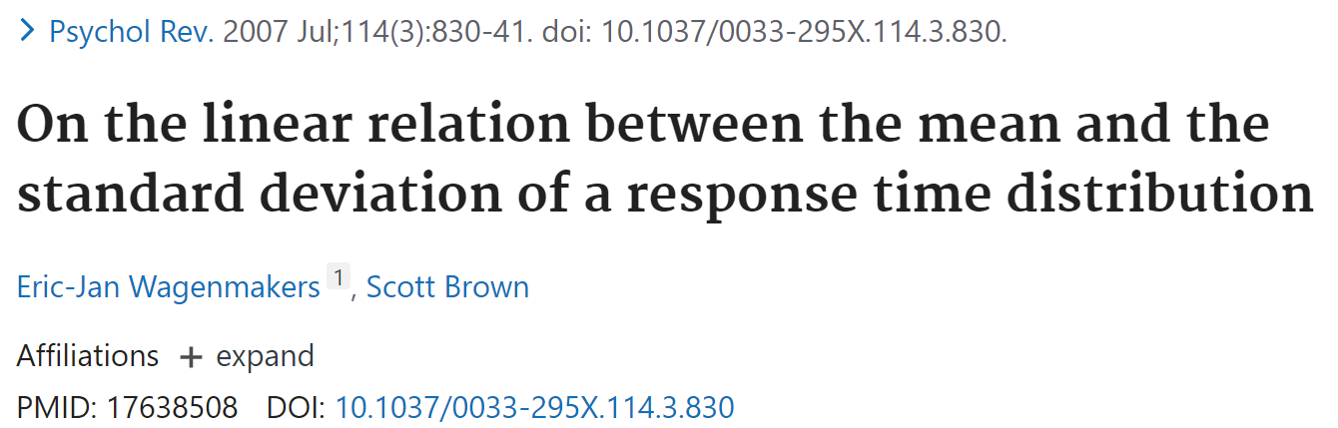
Difference Scores
Variability in standard deviation per trial-type
Incongruent mean
-
Congruent mean

Slide 38
Standard deviation
δ

Slide 39
Difference Scores
Traditional use of difference scores
Has measurement issues
Affects reliability
Should be used with care
Still the most common statistical “model” in psychology

Slide 40
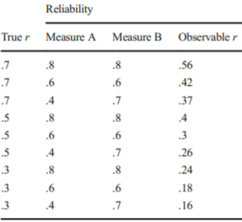

Importance of Reliability
Spearman, 1904:
Measurement error attenuates attainable correlations:
Source: Hedge et al., 2018
$$r_{x′y′} =\frac{r_{xy}}{\sqrt{r_{xx}r_{yy}}}$$

Slide 41
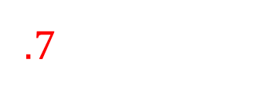
Influence of Reliability on Correlations
Spearman, 1904:
Measurement error attenuates attainable correlations:
Source: Hedge et al., 2018
$$.7 =\frac{r_{xy}}{\sqrt{r_{xx}r_{yy}}}$$

Slide 42
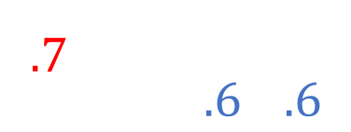
Influence of Reliability on Correlations
Spearman, 1904:
Measurement error attenuates attainable correlations:
Source: Hedge et al., 2018
$$.7 =\frac{r_{xy}}{\sqrt{\left(.6\right)(.6)}}$$

Slide 43
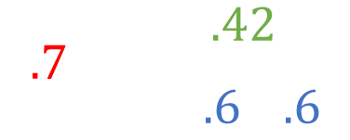
Influence of Reliability on Correlations
Spearman, 1904:
Measurement error attenuates attainable correlations:
Source: Hedge et al., 2018
$$.7 =\frac{.42}{\sqrt{\left(.6\right)(.6)}}$$

Slide 44
Quick Summary
Cognitive Control is important

Slide 45
Quick Summary
Cognitive Control is important
Psychometric issues
Weak between-task correlations
Poor reliability
Common use of difference scores
Examine measurement issues before discarding construct

Slide 46
III. Research on Cognitive Control Reliability
Frequentist Approach

Slide 47
Research Questions
Can existing experimental tasks provide reliable individual difference estimates of cognitive control?
Do the weak between-task correlations of cognitive control stem from reliability issues?

Slide 48
Research Questions
Introduce theoretically motivated task manipulations
Increases between-subject variance
Improves reliability
Loosens constraint on between-task correlations

Slide 49
Research Questions
Introduce theoretically motivated task manipulations
Increases between-subject variance
Improves reliability
Loosens constraint on between-task correlations
Hierarchical Bayesian Analysis
Alternative to traditional aggregate statistics
Addresses psychometric issues

Slide 50
Theoretically Motivated Task Manipulations:
Dual Mechanisms of Cognitive Control (DMC)
Braver et al., 2007; Braver 2012

Slide 51
Theoretically Motivated Task Manipulations:
Dual Mechanisms of Cognitive Control (DMC)
Braver et al., 2007; Braver 2012
Proactive Control: Anticipating future needs (Preparing)

Slide 52
Theoretically Motivated Task Manipulations:
Dual Mechanisms of Cognitive Control (DMC)
Braver et al., 2007; Braver 2012
Proactive Control: Anticipating future needs (Preparing)
Reactive Control: postponing control until needed (Reacting)

Slide 53
Theoretically Motivated Task Manipulations:
DMC task battery (Braver, Bugg, Conway)
Standard (baseline), Proactive, and Reactive Variants of:
Stroop
AX-CPT
Cued Task-Switching
Sternberg Working Memory (a recent probes version)

Slide 54
Theoretically Motivated Task Manipulations:
DMC task battery (Braver, Bugg, Conway)
Standard (baseline), Proactive, and Reactive Variants of:
Stroop: Inhibition
AX-CPT: Context processing
Cued Task-Switching: Task-switching
Sternberg Working Memory: Working memory

Slide 55
Theoretically Motivated Task Manipulations:
DMC task battery variants:
Capture individual variability in proactive and reactive control

Slide 56
Theoretically Motivated Task Manipulations:
DMC task battery variants:
Capture individual variability in proactive and reactive control
Each task:
Baseline: no bias in proactive or reactive control
Proactive: shifts toward proactive control
Reactive: engages reactive control

Slide 57
Method
DMC Task Battery
Subjects
N = 129
Age 22 - 64; Mean = 37; Standard Deviation = 9.9
82 Females, 47 Males
Mturk (Online)

Slide 58
Method
Design and Procedure
Test – Retest, 3 weeks apart
30 sessions: 15 at test, 15 at retest
Session: 20-40 minutes
Compensation: $122 US
Within Test/Retest, session order was fixed

Slide 59
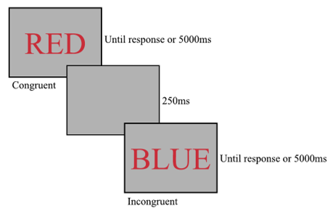
Tasks: Stroop
Color-naming
Vocal

Slide 60
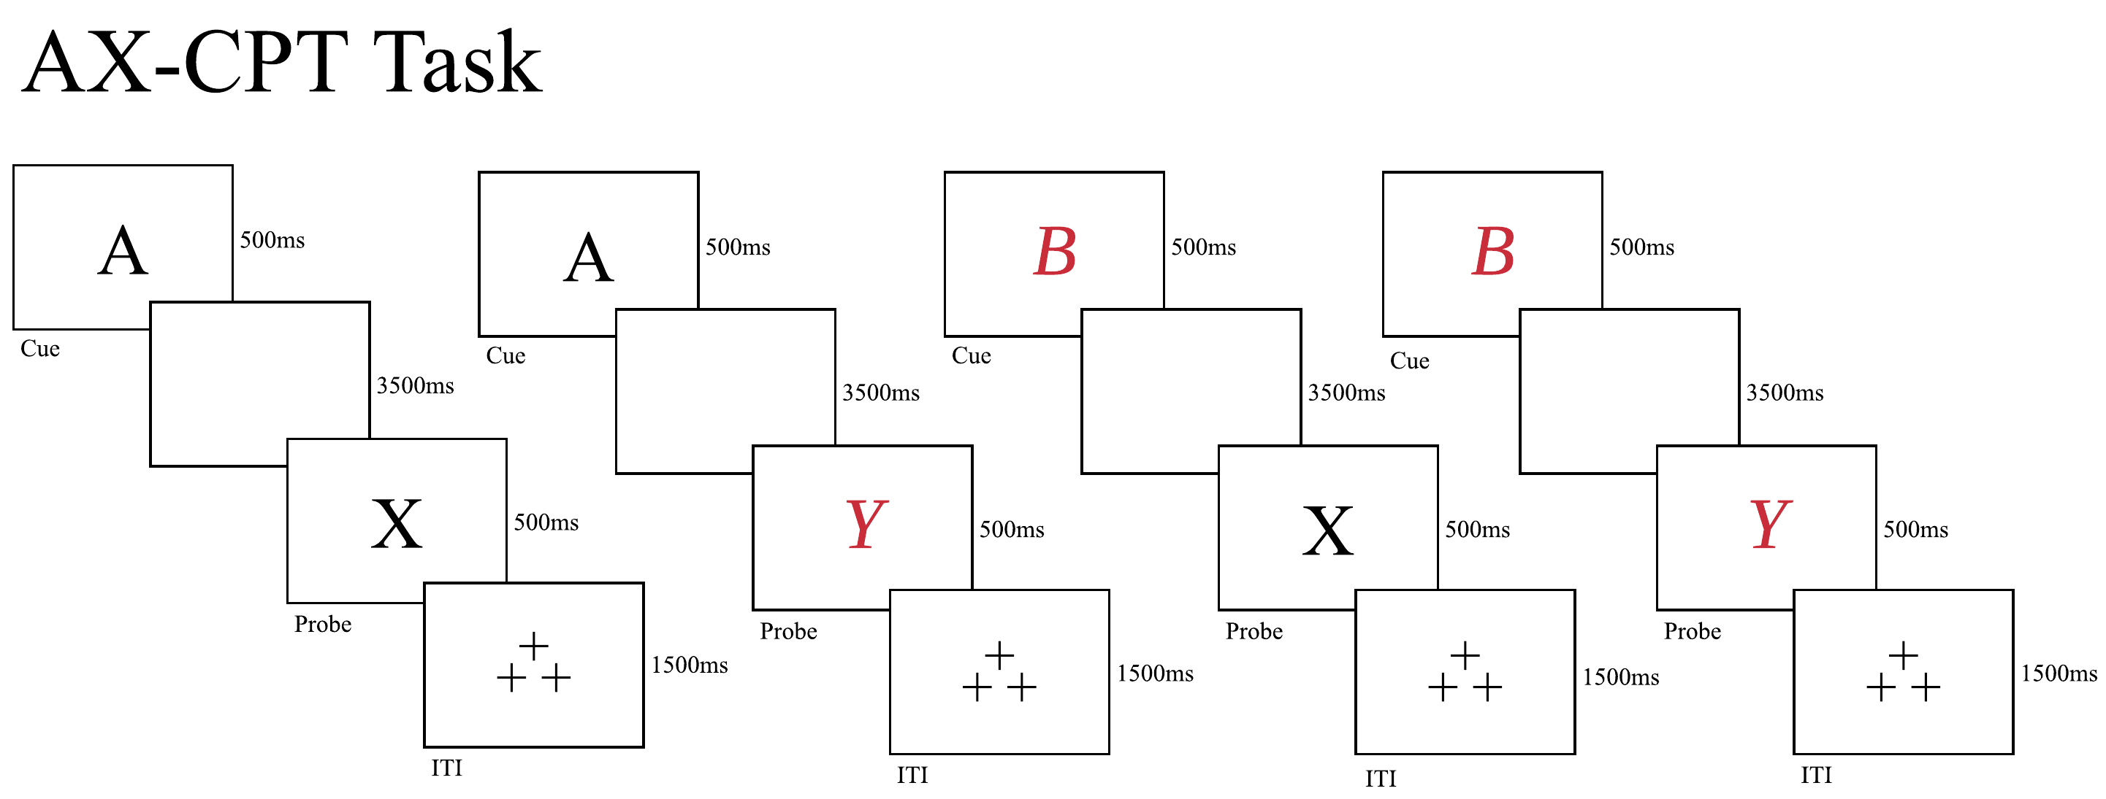
Tasks: AX-CPT

Slide 61
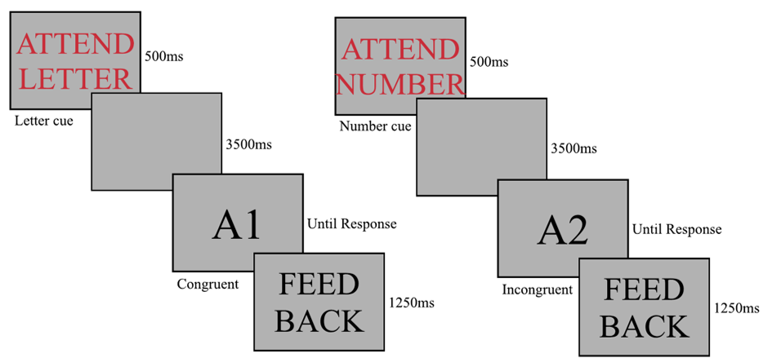
Tasks: Task-Switching

Slide 62
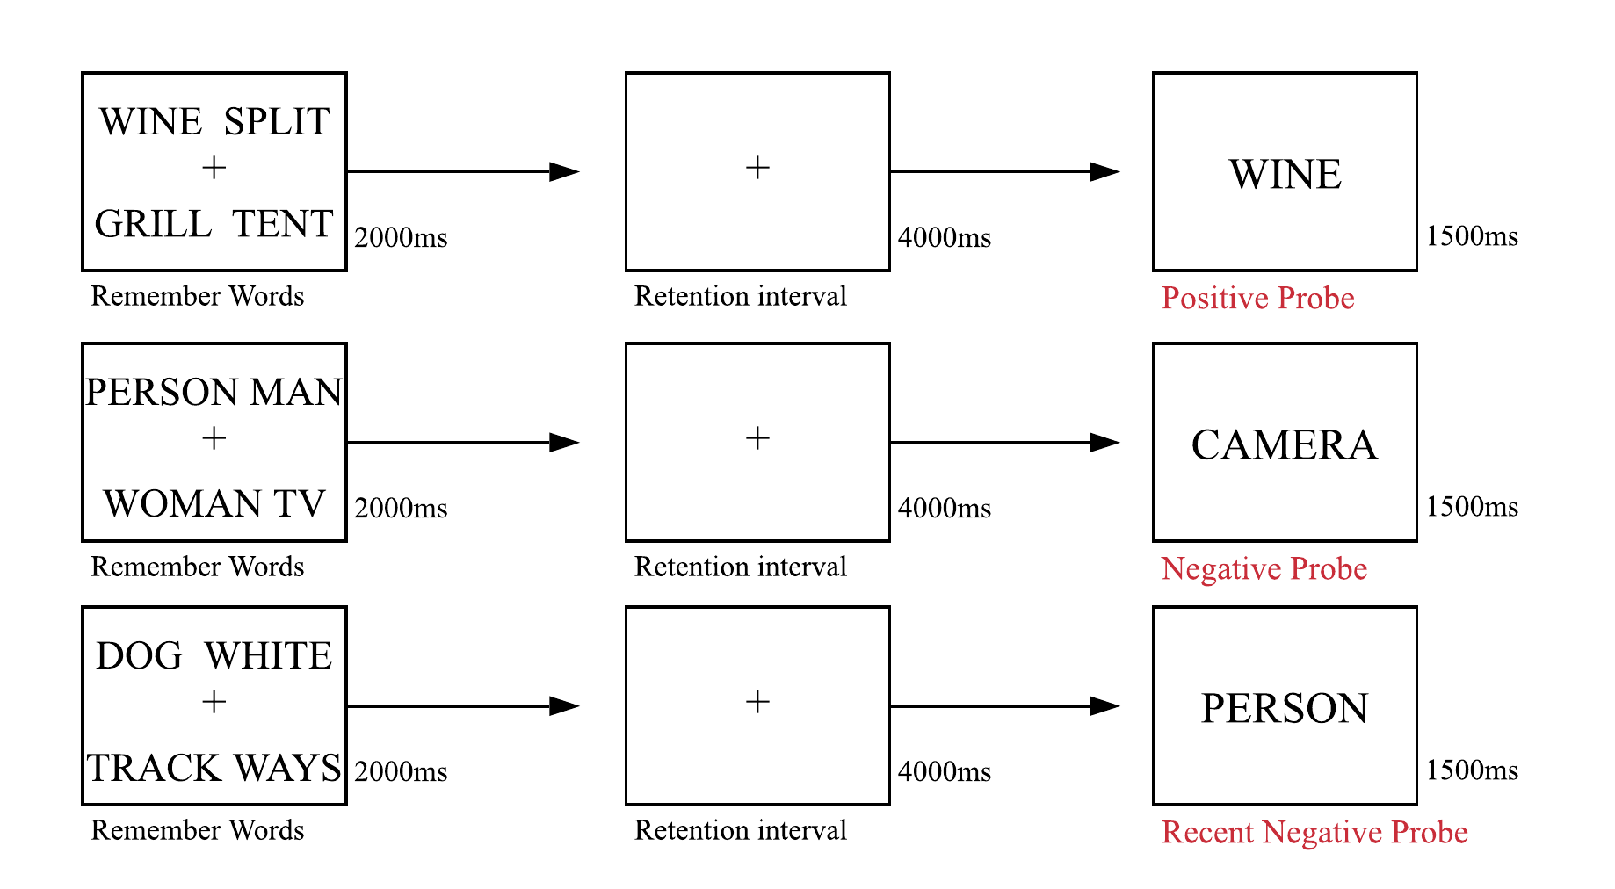
Tasks: Sternberg (recent probes version)

Slide 63
Task Manipulations
Stroop:
Baseline: Proportion Congruency ( Braver et al., 2007)
Proactive: Congruent, Incongruent
Reactive: Item-specific congruence

Slide 64
Task Manipulations
AX-CPT
Proactive: Strategy training (Gonthier et al., 2016)
Reactive: Item-specific probe cueing (Tang et al., 2022)

Slide 65
Task Manipulations
Task-Switching: Proportion Congruency/reward and punishment
Proactive session: mostly congruent (67%; Bugg & Braver, 2016)
Reward: building up bonus money
Reactive session: mostly incongruent (75%)
Punishment: decrease in bonus money

Slide 66
Task Manipulations
Sternberg: WM load/recent negative frequency
Burgess & Braver, 2010
Proactive: Low WM load (2-5 items) & Low RN frequency (20%)
Reactive: High WM load (5-8 items) & High RN frequency (80%)

Slide 67
Results: Reliabilities
Internal Consistency
Parsons et al., 2019
Permutation-based split-half correlations
5000 permutations
Spearman-Brown correction

Slide 68
Results: Reliabilities
Internal Consistency
Parsons et al., 2019
Permutation-based split-half correlations
5000 permutations
Spearman-Brown correction
Test-Retest Reliability
Intraclass correlation coefficients (ICC2,1; ICC3,1)
Absolute agreement; Consistency
Two-way random effects
Single rater

Slide 69
Results: Reliabilities
576 reliability estimates
Reaction Time Difference Scores:
Stroop Effect: incongruent – congruent
Task Switching TRCE: incongruent – congruent
AX-CPT BX Interference: BX – BY
Sternberg Recency Effect: RN - NN
Interference – non-interference trials

Slide 70
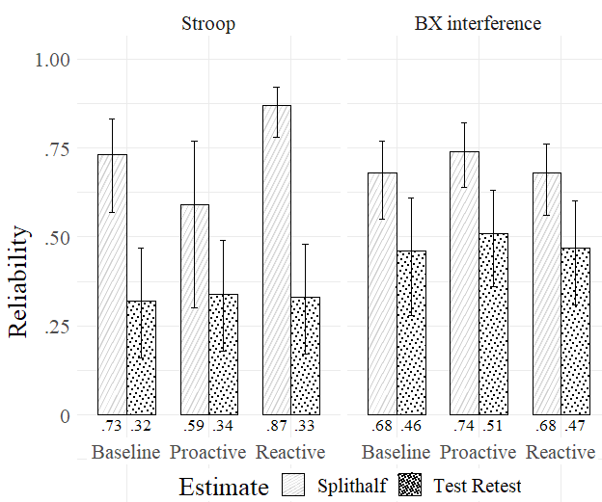
Results: Reliability Difference Scores
Error bars: 95% Confidence Intervals

Slide 71
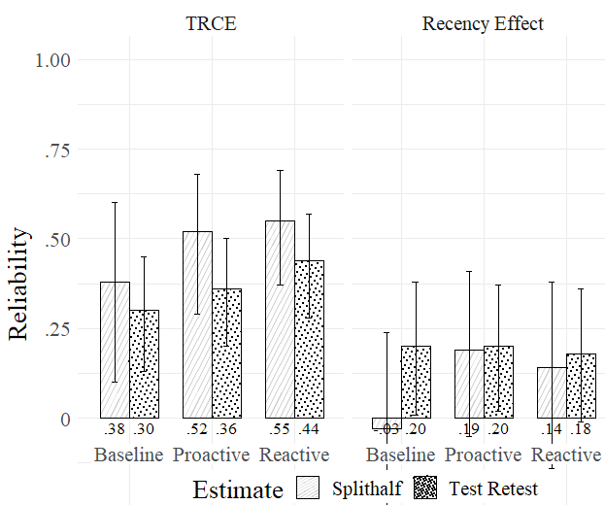
Results: Reliability Difference Scores
Error bars: 95% Confidence Intervals

Slide 72
Results: Reliability Difference Scores
Stroop, AX-CPT, Task-Switching:
Splithalf, moderately reliable
Test Retest, poorly reliable
Task manipulations, no demonstrative improvements

Slide 73
Results: Reliability Difference Scores
Stroop, AX-CPT, Task-Switching:
Splithalf, moderately reliable
Test Retest, poorly reliable
Task manipulations, no demonstrative improvements
Sternberg:
More trials for individual differences reliability

Slide 74
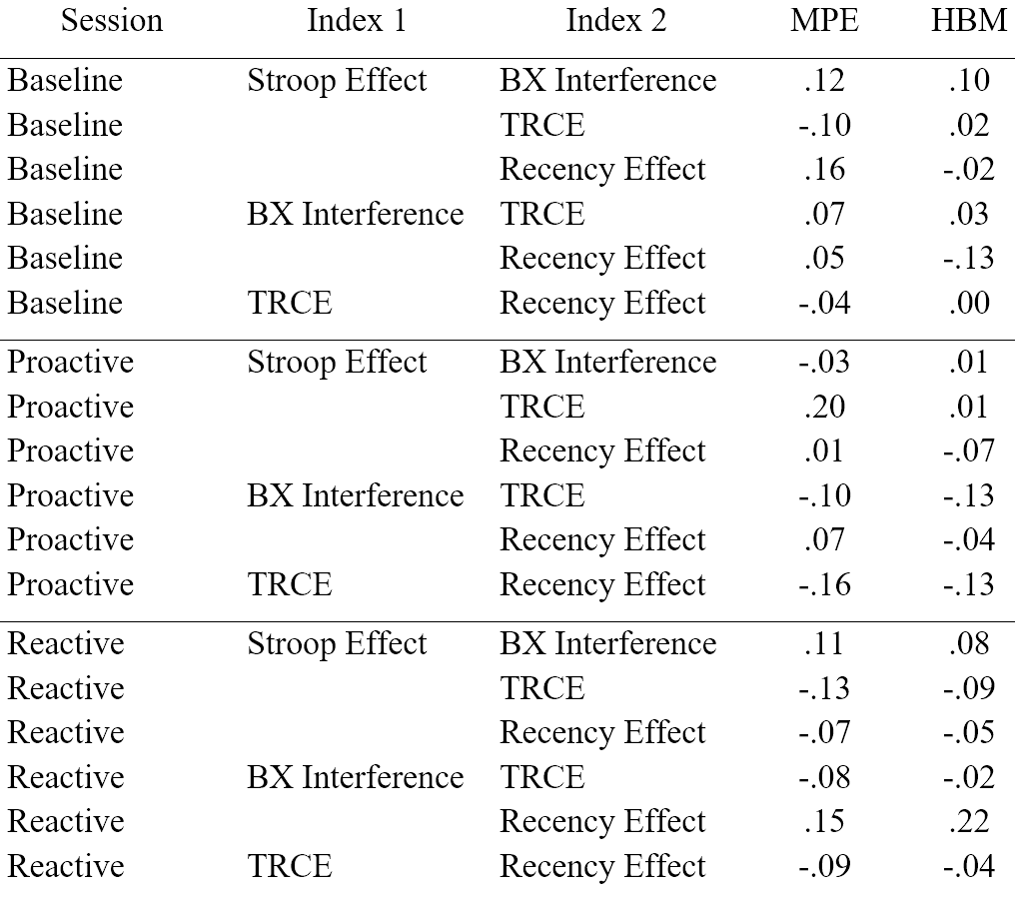
Between-Task Correlations
Pearson r

Slide 75
Results: Summary
Experimental robustness was a success (not presented here)
See Tang et al., 2022
Frequentist individual differences reliability:
Not successful
Replicated previous results of unreliability and poor between-task correlations

Slide 76
Results: Summary
Stroop, AX-CPT, Task-Switching:
Poor to moderate reliability
Task manipulations: no demonstrative improvements
Sternberg: more trials for individual differences reliability
Low between-task correlations?
Unclear due to low reliability

Slide 77


Slide 78
IV. Research on Cognitive Control Reliability
Hierarchical Bayesian Approach

Slide 79
Hierarchical Bayesian Analysis
Hierarchical RE-analysis
Difference scores (interference – noninterference)
Stroop Effect
BX Interference (AX-CPT)
TRCE (Task Switching)
Recency Effect (Sternberg)

Slide 80
Hierarchical Bayesian Analysis
Traditional Approach
Uses aggregated Mean Point-Estimates (MPE)
Doesn’t model trial-to-trial variability
Rouder and Haaf, 2019

Slide 81
Hierarchical Bayesian Analysis
Traditional Approach
Uses aggregated Mean Point-Estimates (MPE)
Doesn’t model trial-to-trial variability
Rouder and Haaf, 2019
Attenuates reliability

Slide 82
Hierarchical Bayesian Analysis
Traditional Approach
Uses aggregated Mean Point-Estimates (MPE)
Doesn’t model trial-to-trial variability
Rouder and Haaf, 2019
Attenuates reliability
Hierarchical Approach
Can model trial-level variability

Slide 83
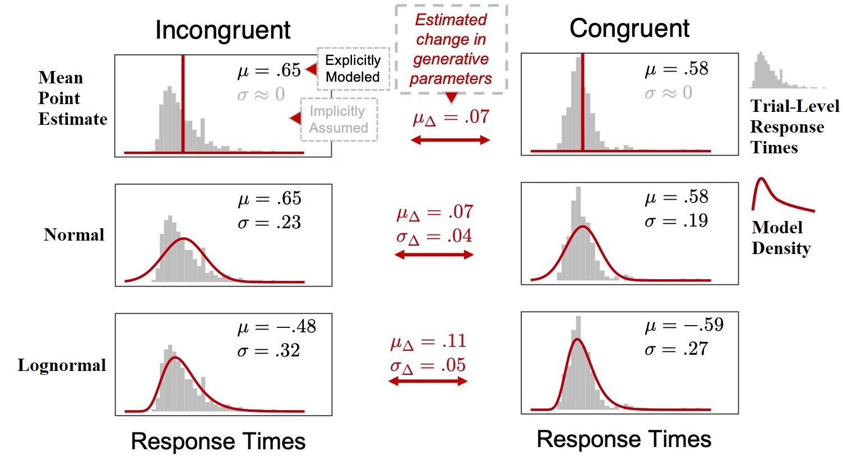
(figure by N. Haines with permission)
Hierarchical Analysis

Slide 84
Hierarchical Analysis
Trial-level variability reflects behavioral information
RT variability and WMC
McVay & Kane, 2011
Mind-wandering frequency impacts variability
McVay & Kane, 2011

Slide 85
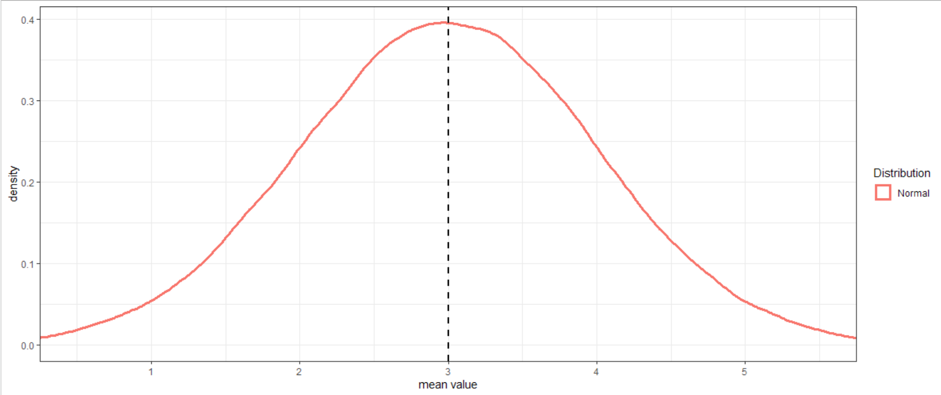
Hierarchical Analysis
Always a normal distribution?
The model implies: yes

Slide 86
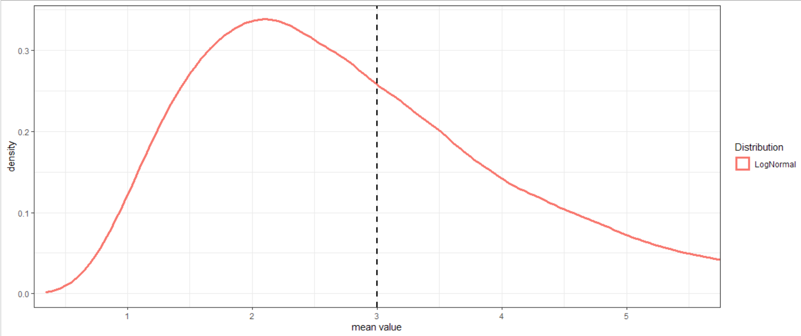
Hierarchical Analysis
Always a normal distribution?
The model implies: yes
Reality: No!
RT distribution are often skewed

Slide 87
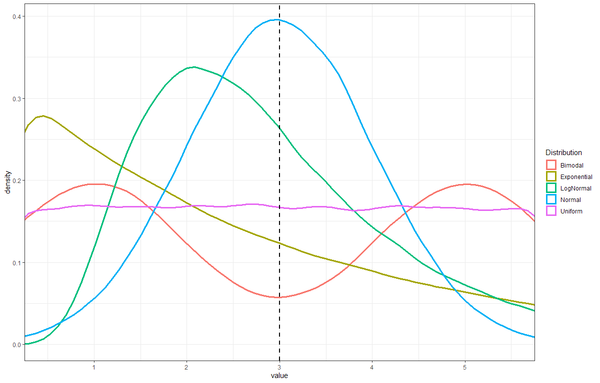
Hierarchical Model

Slide 88
Hierarchical Model
Important aspects can be inferred from:
Trial-level variation
Johnson & Busemeyer, 2005
Distribution family
Kvam, 2019
Distribution Skewness
Leth-Steensen et al., 2000

Slide 89
Hierarchical Model
Important aspects can be inferred from:
Trial-level variation
Johnson & Busemeyer, 2005
Distribution family
Kvam, 2019
Distribution skewness
Leth-Steensen et al., 2000
Model should reflect these aspects
Hierarchical Modeling

Slide 90
Hierarchical Model
Individual-Level Parameter Model
$${RT}_{i,c,p} \sim Lognormal(μ_{i,c,p },{exp(σ}_{i,c,p}))$$

Slide 91
Hierarchical Model
Individual-Level Parameter Model
$${RT}_{i,c,p} \sim Lognormal(μ_{i,c,p },{exp(σ}_{i,c,p}))$$

Slide 92
Hierarchical Model
Individual-Level Parameter Model
$${RT}_{i,c,p} \sim Lognormal(μ_{i,c,p },{exp(σ}_{i,c,p}))$$

Slide 93


Hierarchical Model
Group-Level Parameter Model
$$μ_{i,c,p }\sim Normal\left(μ_{mean, c,p}, μ_{sd,c,p}\right)$$
$$σ_{i,c,p }\sim Normal\left(σ_{mean, c,p}, σ_{sd,c,p}\right)$$

Slide 94
Hierarchical Model
Hierarchical Pooling
$$μ_{i,c,p }\sim Normal\left(μ_{mean, c,p}, μ_{sd,c,p}\right)$$
Group-level
$$σ_{i,c,p }\sim Normal\left(σ_{mean, c,p}, σ_{sd,c,p}\right)$$
Individual-level
$${RT}_{i,c,p} \sim Lognormal(μ_{i,c,p },{exp(σ}_{i,c,p}))$$

Slide 95
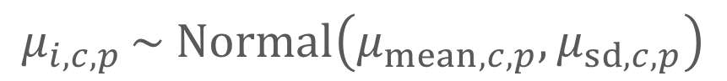
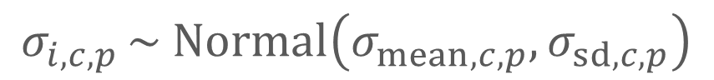
Hierarchical Model
Hierarchical Pooling
$$μ_{i,c,p }\sim Normal\left(μ_{mean, c,p}, μ_{sd,c,p}\right)$$
Group-level
$$σ_{i,c,p }\sim Normal\left(σ_{mean, c,p}, σ_{sd,c,p}\right)$$
Individual-level
$${RT}_{i,c,p} \sim Lognormal(μ_{i,c,p },{exp(σ}_{i,c,p}))$$

Slide 96
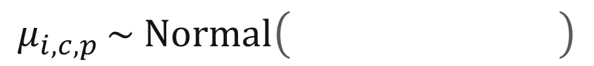
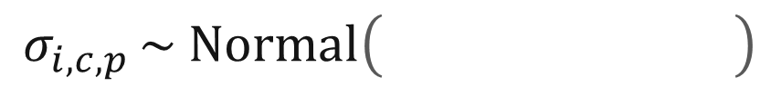
Hierarchical Model
Hierarchical Pooling
$$μ_{i,c,p }\sim Normal\left(μ_{mean, c,p}, μ_{sd,c,p}\right)$$
Group-level
$$σ_{i,c,p }\sim Normal\left(σ_{mean, c,p}, σ_{sd,c,p}\right)$$
Individual-level
$${RT}_{i,c,p} \sim Lognormal(μ_{i,c,p },{exp(σ}_{i,c,p}))$$

Slide 97
Hierarchical Model
Hierarchical Pooling
$$μ_{i,c,p }\sim Normal\left(μ_{mean, c,p}, μ_{sd,c,p}\right)$$
Group-level
$$σ_{i,c,p }\sim Normal\left(σ_{mean, c,p}, σ_{sd,c,p}\right)$$
Individual-level
$${RT}_{i,c,p} \sim Lognormal(μ_{i,c,p },{exp(σ}_{i,c,p}))$$

Slide 98
Hierarchical Model
Hierarchical Pooling
Shrinkage
Increases precision
$$μ_{i,c,p }\sim Normal\left(μ_{mean, c,p}, μ_{sd,c,p}\right)$$
Group-level
$$σ_{i,c,p }\sim Normal\left(σ_{mean, c,p}, σ_{sd,c,p}\right)$$
Individual-level
$${RT}_{i,c,p} \sim Lognormal(μ_{i,c,p },{exp(σ}_{i,c,p}))$$

Slide 99
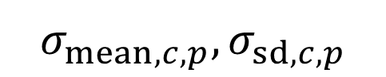
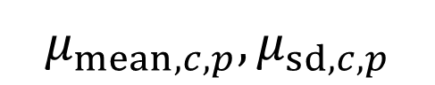
Hierarchical Bayesian Model
Simultaneous
estimation
Individual-level
Group-level
$$\left(μ_{mean, c,p}, μ_{sd,c,p}\right)$$
$${RT}_{i,c,p} \sim Lognormal(μ_{i,c,p },{exp(σ}_{i,c,p}))$$
$$\left(σ_{mean, c,p}, σ_{sd,c,p}\right)$$

Slide 100
Hierarchical Bayesian Model
Cross-level learning
As opposed to independent estimations (MLM)
Improves signal from measurement error determination
Individual-level
Group-level
Simultaneous
estimation

Slide 101
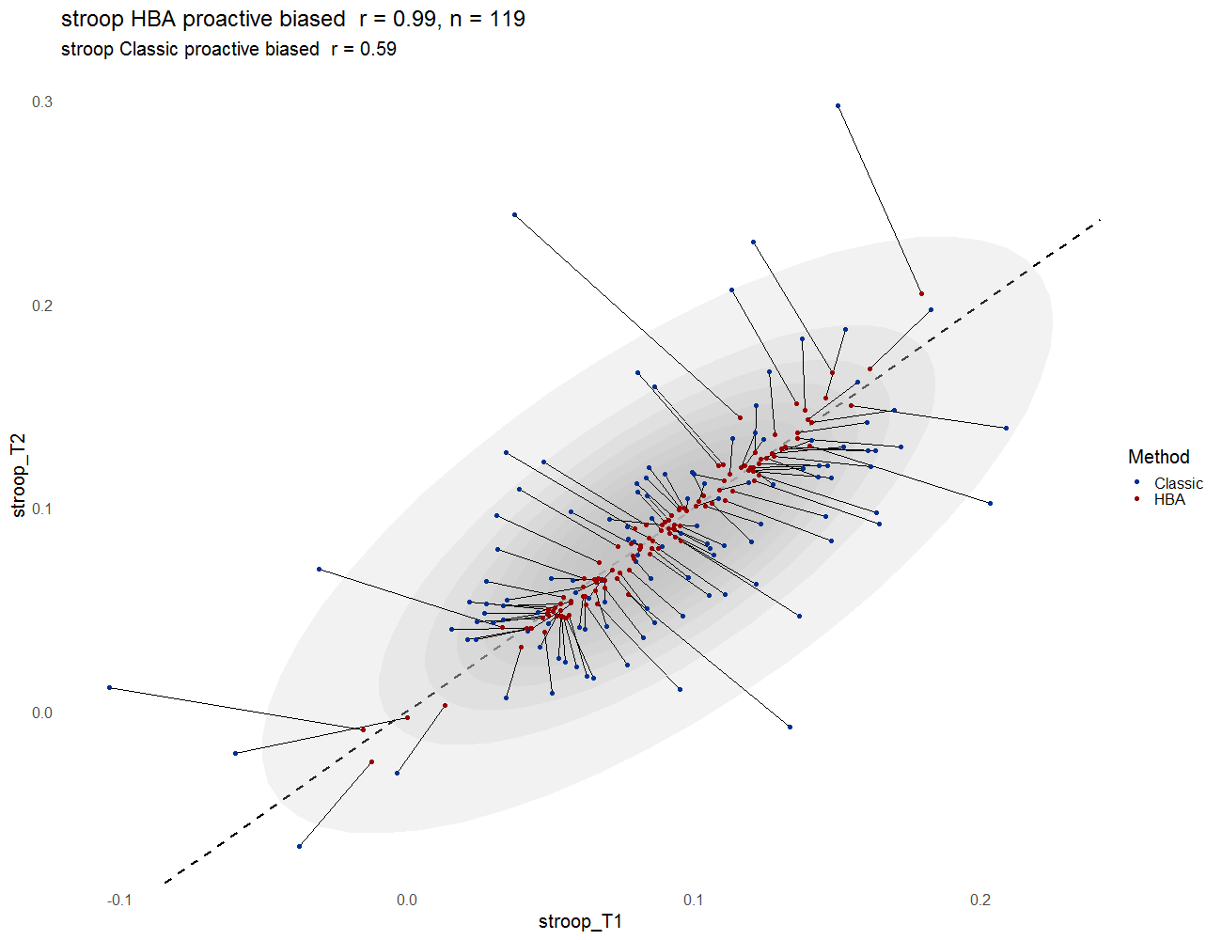
Traditional
HBA

Slide 102
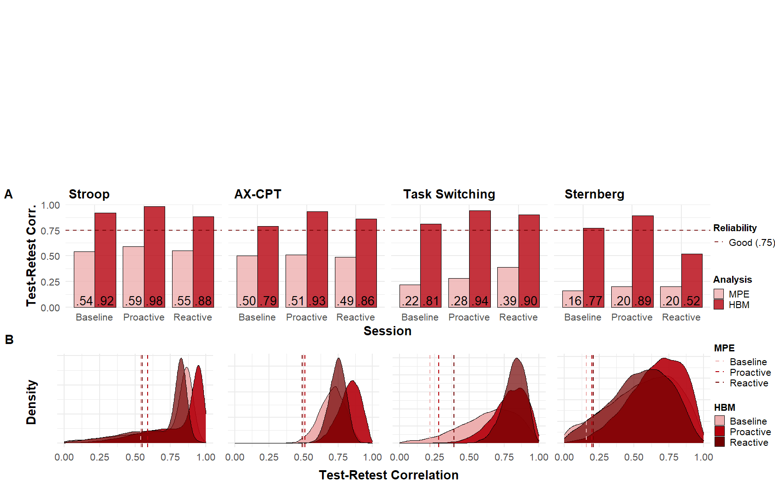
Reliability Comparison: MPE vs. HBM

Slide 103
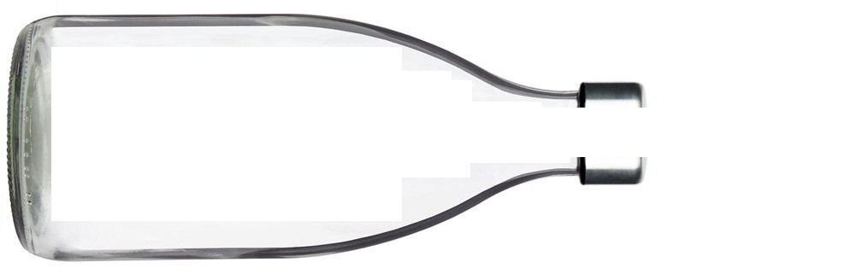
Results
True Correlations:
Reliability:
Observable:
Low reliability
Inaccurate Low Between-task correlations
High Between-task correlations

Slide 104
Results
True Correlations:
Reliability:
Observable:
Low reliability
High Between-task correlations
Accurate Between-task correlations

Slide 105
Between-Task Correlations

Slide 106
Discussion
Hierarchical Bayesian = reliable individual differences
Chen et al., 2021; Haines et al., 2020; Rouder & Haaf, 2019
What should be modeled?
Individual-level variability
Distribution properties

Slide 107
Discussion
Individual differences in Cognitive Control
Correlations bottlenecked by Reliability?
No

Slide 108
Discussion
Individual differences in Cognitive Control
Correlations bottlenecked by Reliability?
No
Cognitive Control not unified
Tasks measure task-specific processes?
Rey-Mermet et al., 2018

Slide 109
Discussion
Individual differences in Cognitive Control
Correlations bottlenecked by Reliability?
No
Cognitive Control not unified
Tasks measure task-specific processes?
Rey-Mermet et al., 2018
Reliability is important
Transparency

Slide 110
Thank You

Slide 111
V. Current Research and Future Directions

Slide 112
A. Sigma

Slide 113
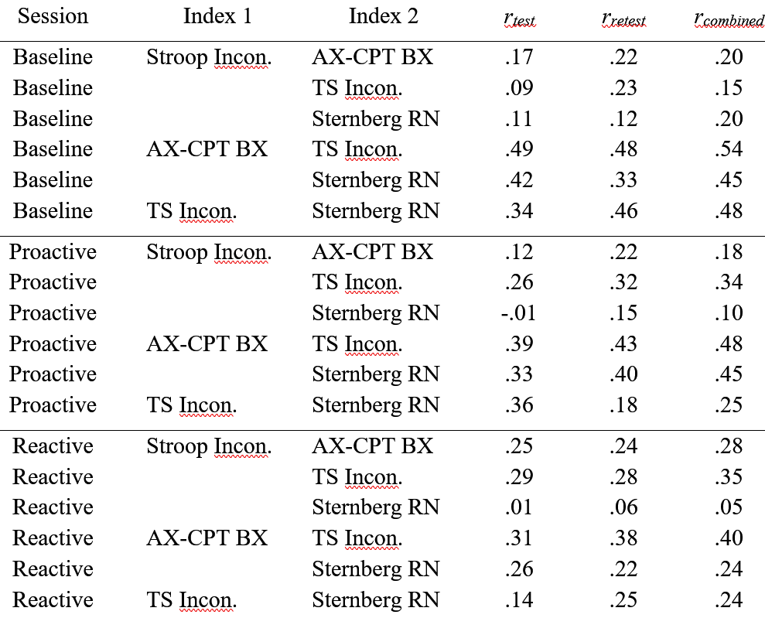
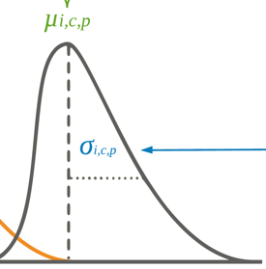
Sigma
Individual-level standard deviation

Slide 114
Sigma
Individual-level standard deviation
Der & Deary, 2006
Salthouse, 2007
Unsworth, 2015

Slide 115
Sigma
Interference Trials
Incongruent etc.
Stroop vs. the rest

Slide 116
Sigma
Interference Trials
Incongruent etc.
AX-CPT
Task-Switching
Sternberg

Slide 117
B. Method

Slide 118
Method
Stan
Rstan (model at osf.io/79jgs)
3000 iterations (+ 1000 warm-up iterations)
12 model runs
4 tasks
3 sessions (Baseline, Proactive, Reactive)
Mu and Sigma = individual-level mean and standard deviation
Sigma aka trial-level variation

Slide 119

Extracted Parameters
12 model runs
4 tasks
3 sessions (Baseline, Proactive, Reactive)
Mu and Sigma = individual-level mean and standard deviation
Sigma aka trial-level variation
Delta = difference score
$$∆_{i,test }= μ_{i,interference,test}− μ_{i,control,test}$$
$$∆_{i,retest }= μ_{i,interference,retest}− μ_{i,control,retest}$$

Slide 120


Extracted Parameters
Delta = $∆$ = difference score
Stroop
$$∆_{i,test }= μ_{i,interference,test}− μ_{i,control,test}$$
$$∆_{i,retest }= μ_{i,interference,retest}− μ_{i,control,retest}$$

Slide 121

Extracted Parameters
Delta = $∆$ = difference score
Stroop
$$∆_{i,test }= μ_{i,interference,test}− μ_{i,control,test}$$
$$∆_{i,retest }= μ_{i,interference,retest}− μ_{i,control,retest}$$
$${∆Stroop}_{i,test }= μ_{i,incongruent,test}− μ_{i,congruent,test}$$
$${∆Stroop}_{i,retest }= μ_{i,incongruent,retest}− μ_{i,congruent,retest}$$

Slide 122


Extracted Parameters
Delta = $∆$ = difference score
r ( )
Test-Retest Reliability
$${∆Stroop}_{i,test }= μ_{i,incongruent,test}− μ_{i,congruent,test}$$
$${∆Stroop}_{i,retest }= μ_{i,incongruent,retest}− μ_{i,congruent,retest}$$

Slide 123
C. Explain Pooling

Slide 124
Types of Pooling
Complete Pooling
Assumes identical behavior (zero variance)
MPE

Slide 125
Hierarchical Bayesian Model
Complete Pooling
Assumes identical behavior (zero variance)
MPE
No Pooling
Behavior is random and unrelated
Infinite variance

Slide 126
Hierarchical Bayesian Model
Complete Pooling
Assumes identical behavior (zero variance)
MPE
No Pooling
Behavior is random and unrelated
Infinite variance
Partial Pooling
Allows varying behavior
Group-level allows individual-level learning

Slide 127
D. All Encompassing Model + BRMS

Slide 129
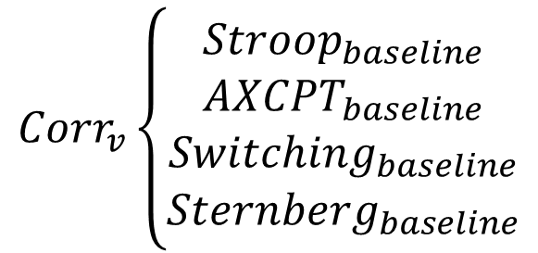
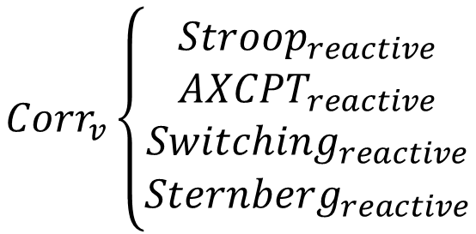
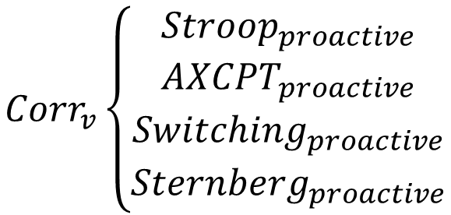
Current Project
Main interest: Correlations
between paradigms
within manipulated variant
Fitting a single model on 4 different paradigms, 3 times
$${Corr}_{v}\left\{\begin{aligned}{Stroop}_{baseline} \\ {AXCPT}_{baseline} \\ {Switching}_{baseline} \\ {Sternberg}_{baseline}\end{aligned}\right.$$
$${Corr}_{v}\left\{\begin{aligned}{Stroop}_{proactive} \\ {AXCPT}_{proactive} \\ {Switching}_{proactive} \\ {Sternberg}_{proactive}\end{aligned}\right.$$
$${Corr}_{v}\left\{\begin{aligned}{Stroop}_{reactive} \\ {AXCPT}_{reactive} \\ {Switching}_{reactive} \\ {Sternberg}_{reactive}\end{aligned}\right.$$

Slide 130
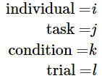
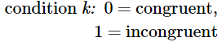
Current Project
Process model: difference score
Rouder, Kumar, Haaf – preprint (2019)

Slide 131
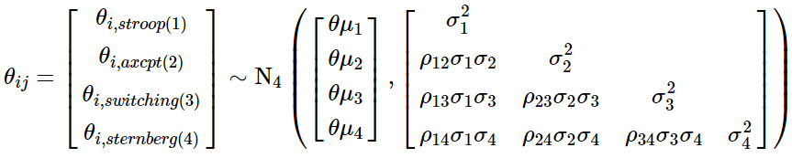
Current Project

Slide 132
Current Project
Extract correlation matrix of rhos from covariance matrix
Cholesky decomposition for efficiency

Slide 133
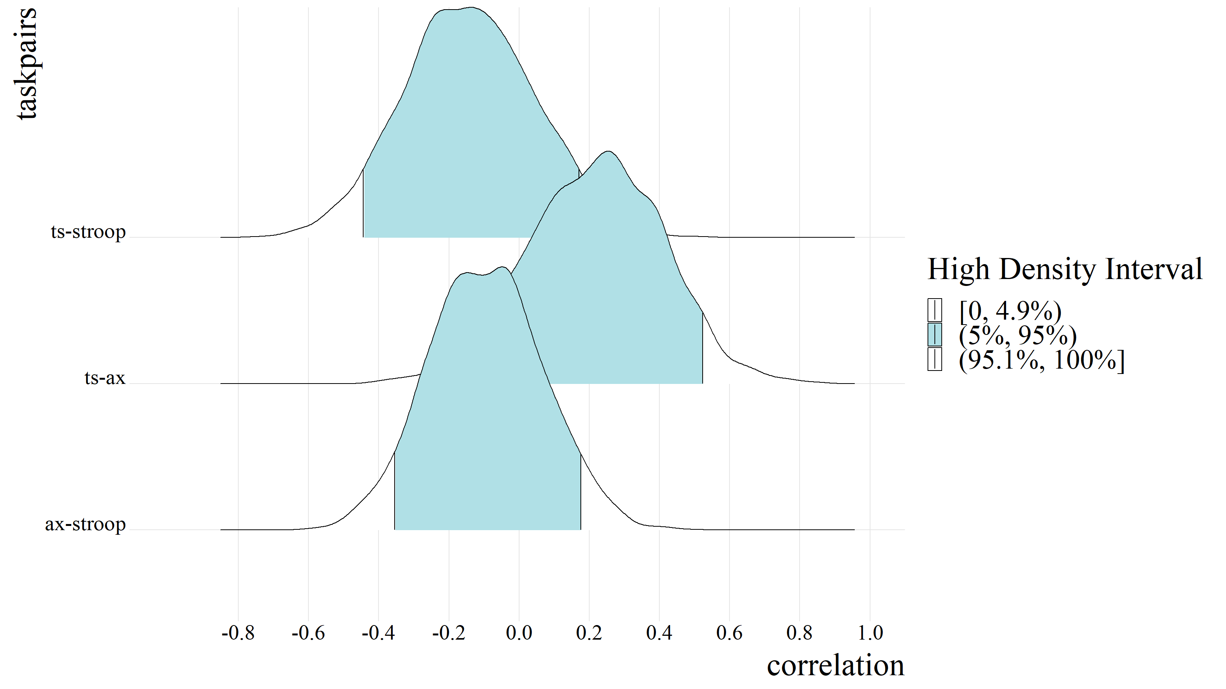
Baseline
-.15
.22
-.10

Slide 134
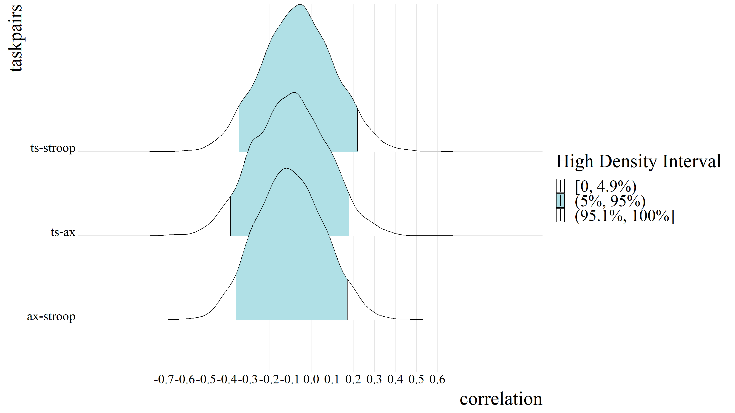
Proactive
-.06
-.10
-.10

Slide 135
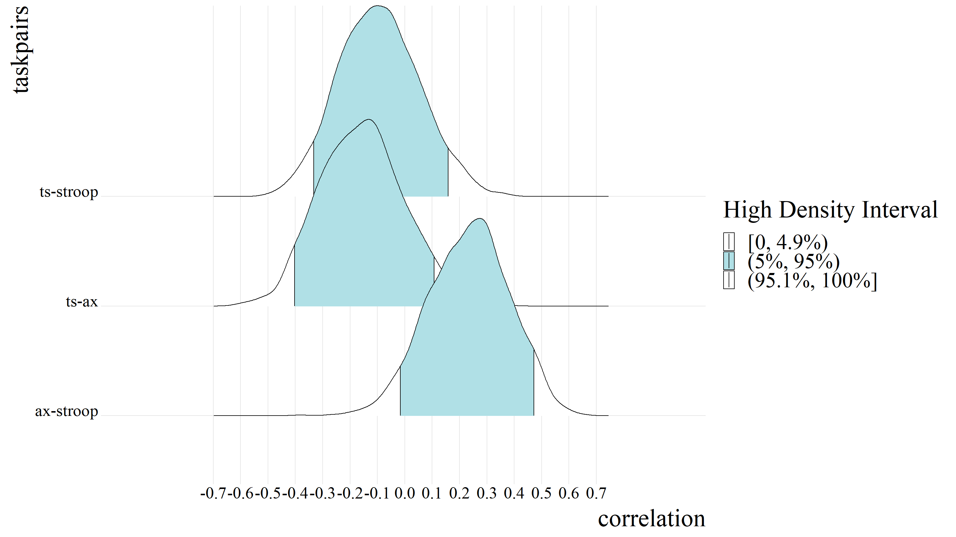
Reactive
-.10
-.16
.24

